Slide 1

Threads
PASS
CS532: OS Foundations
Lab Assignment
email address: parth2@pdx.edu
partner’s email address:

Slide 2
Instructions: Make a copy of this document, move your copy to your submissions folder and fill the document with your responses. Use the space on each slide to show your responses, and add additional slides as needed.
When ready for grading: complete the lab assignment submission form and include a link to your filled document

Slide 3
sum.c
Your assignment is to read, understand, build, run and improve the sum.c program. Begin by reading and understanding the sum.c source code which is linked from the course plan document.
Next, build and run the original sum.c program as described in the source code. When you run the original version it should fail!

Slide 4
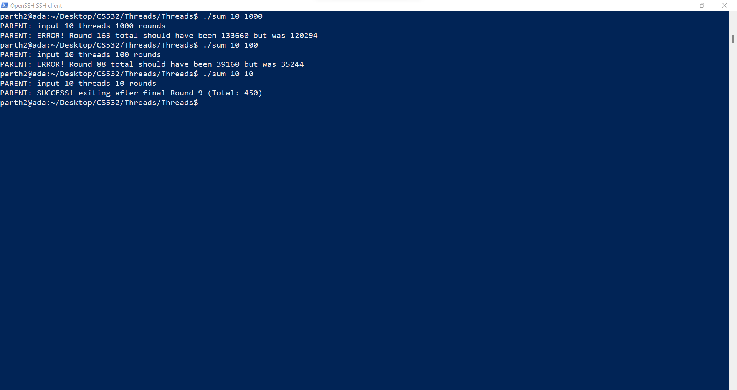

Slide 5
1. Why does the original sum program fail? What is wrong with it?
Answer:- The program fails because when the threads are declared and used in the functions, then there is no synchronisation in the threads and they all try to access the same variable(s) which leads to faulty results.
This is a classic example of what happens when multiple threads try to access the same variables without any synchronisation and locking mechanism between them.

Slide 6
2. Modify the sum.c source code to create a new version named sum2.c that calculates the sums correctly and consistently using multiple threads. Test sum2 with 4 threads and various numbers of Rounds such as 2, 20, 200, 2000. Keep the code INEFFICIENT in that every thread updates the global Total on every iteration of its inner loop. If your code takes longer than 2 minutes to run, then stop it and run with a lower number of Rounds.
Upload your sum2.c file to your submissions folder and provide a link to it here: https://drive.google.com/file/d/1aj_g6v8tikVu7bKE2xf4L19P15qFm6xB/view?usp=sharing
Code looks good

Slide 7
#include <pthread.h>
#include <stdio.h>
#include <stdlib.h>
#include <unistd.h>
#define MAXTHREADS 10
volatile unsigned long long Round = 0ULL;
volatile unsigned long long Total = 0ULL;
pthread_mutex_t mVar=PTHREAD_MUTEX_INITIALIZER;
void *Summation(void *tidptr)
{
for (unsigned long long dex = 0ULL; dex <= Round; dex++) {
pthread_mutex_lock(&mVar);
Total += dex;
pthread_mutex_unlock(&mVar);
}
return NULL;
}

Slide 8
void doOneRound(unsigned long long thisRound, int numthreads)
{
int tids[MAXTHREADS] = {0,1,2,3,4,5,6,7,8,9};
pthread_t t[numthreads];
int rc;
for (int i = 0; i < numthreads; i++) {
rc = pthread_create(&t[i], NULL, Summation, (void *) &tids[i]);
if (rc){
printf("ERROR; return code from pthread_create() is %d\n", rc);
exit(-1);
}
}
for (int i = 0; i < numthreads; i++) {
rc = pthread_join(t[i], NULL);
if (rc != 0) {
fprintf(stderr, "ERROR joining with thread %d (error==%d)\n", tids[i], rc);
exit(-1);
}
}
}

Slide 9
void checkResult(unsigned long long thisRound, int numthreads)
{
unsigned long long calc = (thisRound * (thisRound + 1ULL)) / 2ULL;
calc *= (unsigned long long) numthreads;
if (Total != calc) {
printf("PARENT: ERROR! Round %llu total should have been %llu but was %llu\n", thisRound, calc, Total);
exit(-1);
}
}
int main(int argc, char *argv[])
{
if (argc != 3) {
fprintf(stderr, "USAGE: %s <nthreads> <max>\n", argv[0]);
exit(-1);
}
int numthreads = atoi(argv[1]);
if ((numthreads < 1) || (numthreads > MAXTHREADS)) {
fprintf(stderr, "ERROR: numthreads must be >= 1 and <= %d\n", MAXTHREADS);
exit(-1);
}

Slide 10
unsigned long long numrounds = strtoull(argv[2], NULL, 0);
if (numrounds <= 0ULL) {
fprintf(stderr, "ERROR: number of rounds must be a positive unsigned long long (not '%s')\n", argv[2]);
exit(-1);
}
printf("PARENT: input %d threads %llu rounds\n", numthreads, numrounds);
for (Round = 1ULL; Round < numrounds; Round++) {
Total = 0ULL;
doOneRound(Round, numthreads);
checkResult(Round, numthreads);
}
printf("PARENT: SUCCESS! exiting after final Round %llu (Total: %llu)\n", numrounds-1, Total);
return(0);
}

Slide 11
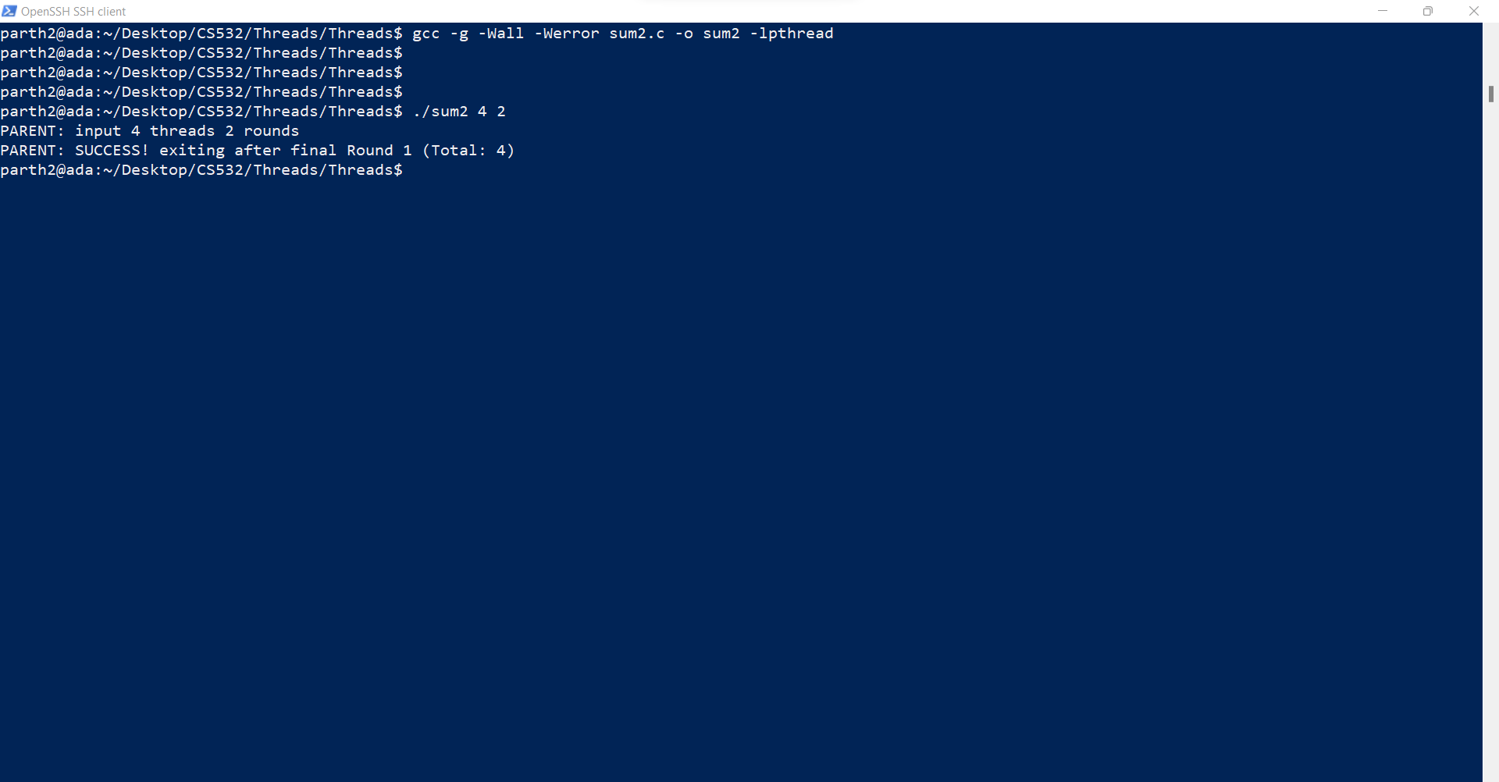
4 Threads and 2 rounds

Slide 12
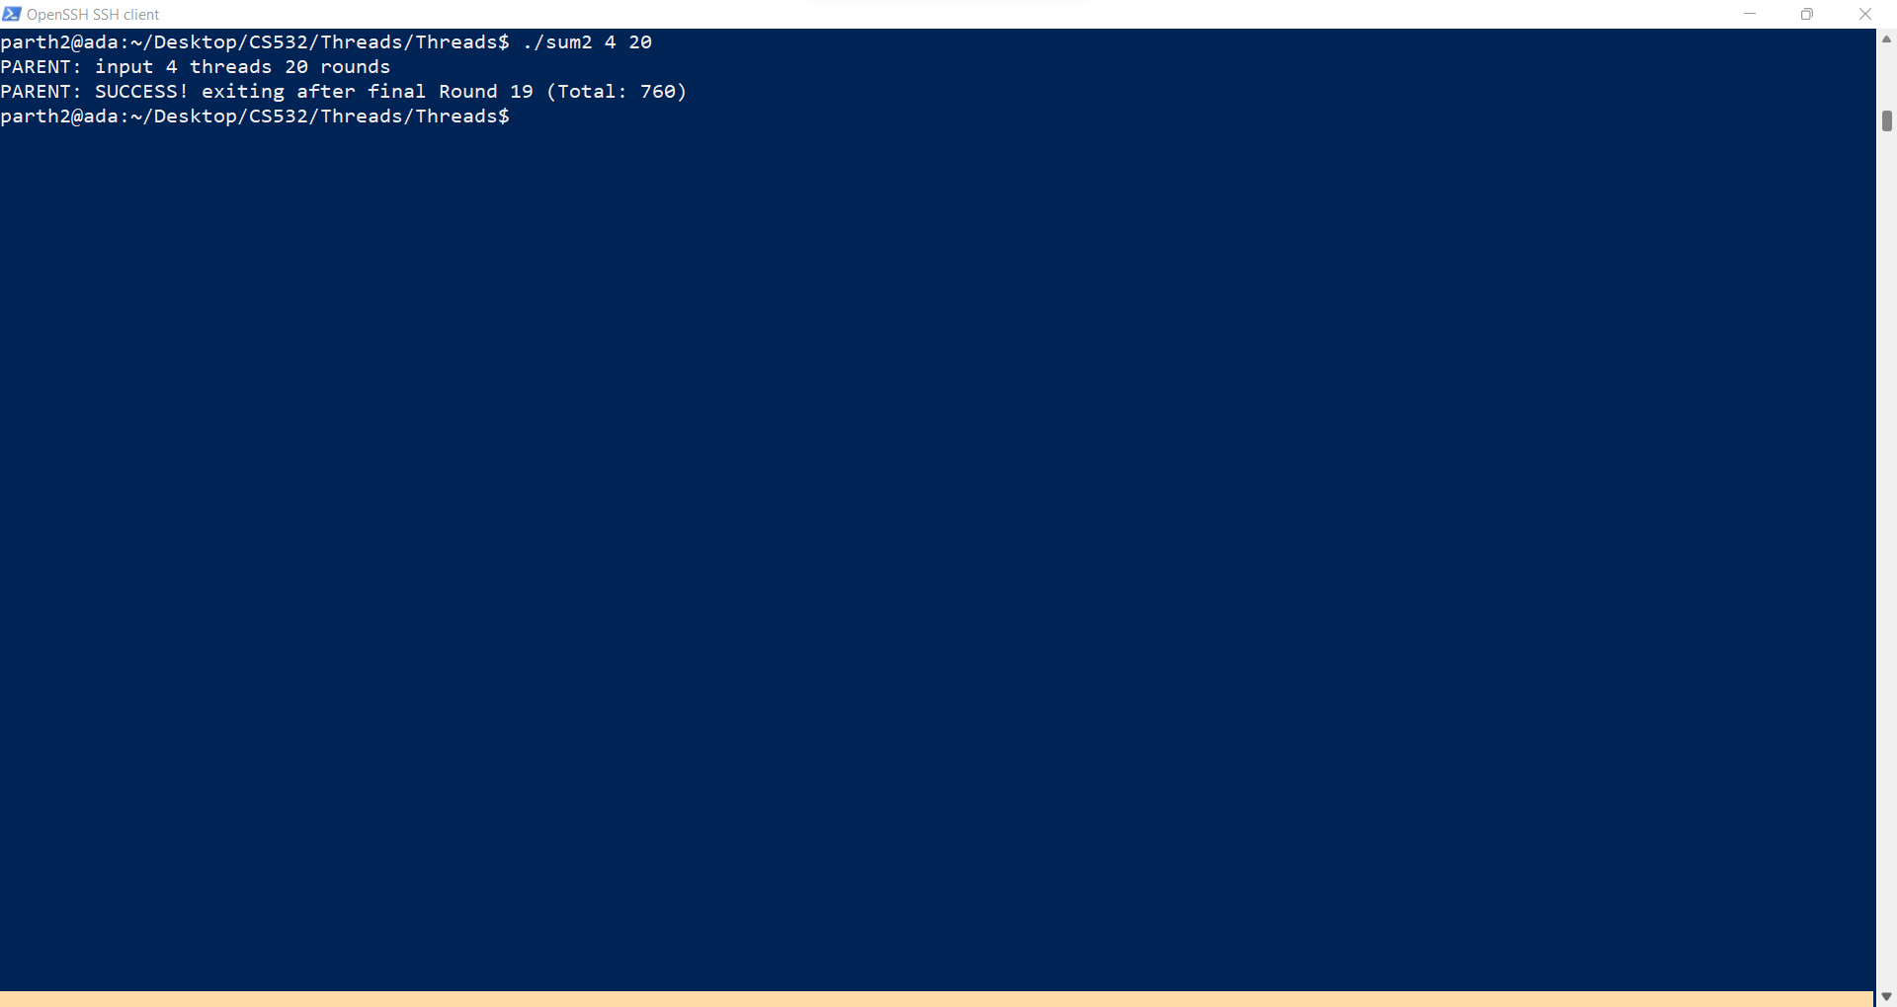
4 Threads and 20 rounds

Slide 13
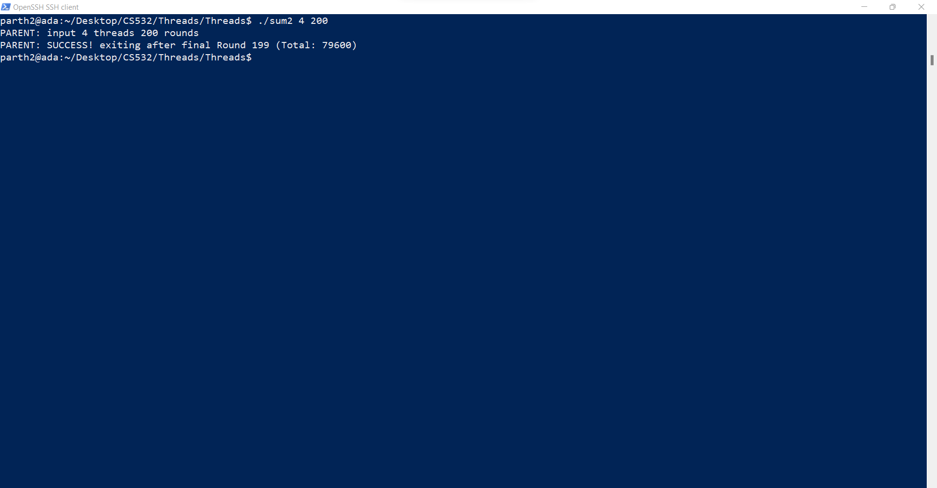
4 Threads and 200 rounds

Slide 14

4 Threads and 2000 rounds

Slide 15
3. Improve your sum2.c source code to produce a new version, called sum3.c, that is more efficient in that each thread calculates its local sum and then modifies the shared Total variable when finished calculating its local total.
Build, Run, Test and Upload sum3.c to your submissions folder and provide a link to it here:
https://drive.google.com/file/d/12LDfKOU9cmGsbFp0C4_eNPhhaJJXAEQy/view?usp=sharing
Code looks good

Slide 16
#include <pthread.h>
#include <stdio.h>
#include <stdlib.h>
#include <unistd.h>
#define MAXTHREADS 10
volatile unsigned long long Round = 0ULL;
volatile unsigned long long Total = 0ULL;
pthread_mutex_t mVar=PTHREAD_MUTEX_INITIALIZER;
void *Summation(void *tidptr)
{
unsigned long long localTotal=0ULL;
for (unsigned long long dex = 0ULL; dex <= Round; dex++) {
localTotal += dex;
}
pthread_mutex_lock(&mVar);
Total += localTotal;
pthread_mutex_unlock(&mVar);
return NULL;
}

Slide 17
void doOneRound(unsigned long long thisRound, int numthreads)
{
int tids[MAXTHREADS] = {0,1,2,3,4,5,6,7,8,9};
pthread_t t[numthreads];
int rc;
for (int i = 0; i < numthreads; i++) {
rc = pthread_create(&t[i], NULL, Summation, (void *) &tids[i]);
if (rc){
printf("ERROR; return code from pthread_create() is %d\n", rc);
exit(-1);
}
}
for (int i = 0; i < numthreads; i++) {
rc = pthread_join(t[i], NULL);
if (rc != 0) {
fprintf(stderr, "ERROR joining with thread %d (error==%d)\n", tids[i], rc);
exit(-1);
}
}
}

Slide 18
void checkResult(unsigned long long thisRound, int numthreads)
{
unsigned long long calc = (thisRound * (thisRound + 1ULL)) / 2ULL;
calc *= (unsigned long long) numthreads;
if (Total != calc) {
printf("PARENT: ERROR! Round %llu total should have been %llu but was %llu\n", thisRound, calc, Total);
exit(-1);
}
}

Slide 19
int main(int argc, char *argv[])
{
if (argc != 3) {
fprintf(stderr, "USAGE: %s <nthreads> <max>\n", argv[0]);
exit(-1);
}
int numthreads = atoi(argv[1]);
if ((numthreads < 1) || (numthreads > MAXTHREADS)) {
fprintf(stderr, "ERROR: numthreads must be >= 1 and <= %d\n", MAXTHREADS);
exit(-1);
}
unsigned long long numrounds = strtoull(argv[2], NULL, 0);
if (numrounds <= 0ULL) {
fprintf(stderr, "ERROR: number of rounds must be a positive unsigned long long (not '%s')\n", argv[2]);
exit(-1);
}
printf("PARENT: input %d threads %llu rounds\n", numthreads, numrounds);
for (Round = 1ULL; Round < numrounds; Round++) {
Total = 0ULL;
doOneRound(Round, numthreads);
checkResult(Round, numthreads);
}
printf("PARENT: SUCCESS! exiting after final Round %llu (Total: %llu)\n", numrounds-1, Total);
return(0);
}

Slide 20
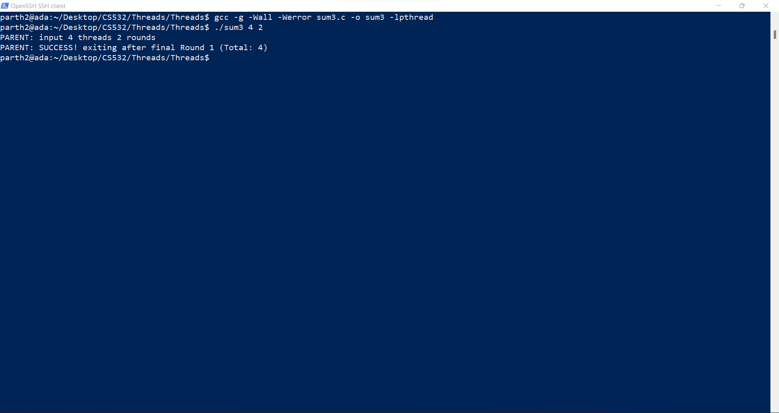
4 Threads and 2 rounds

Slide 21
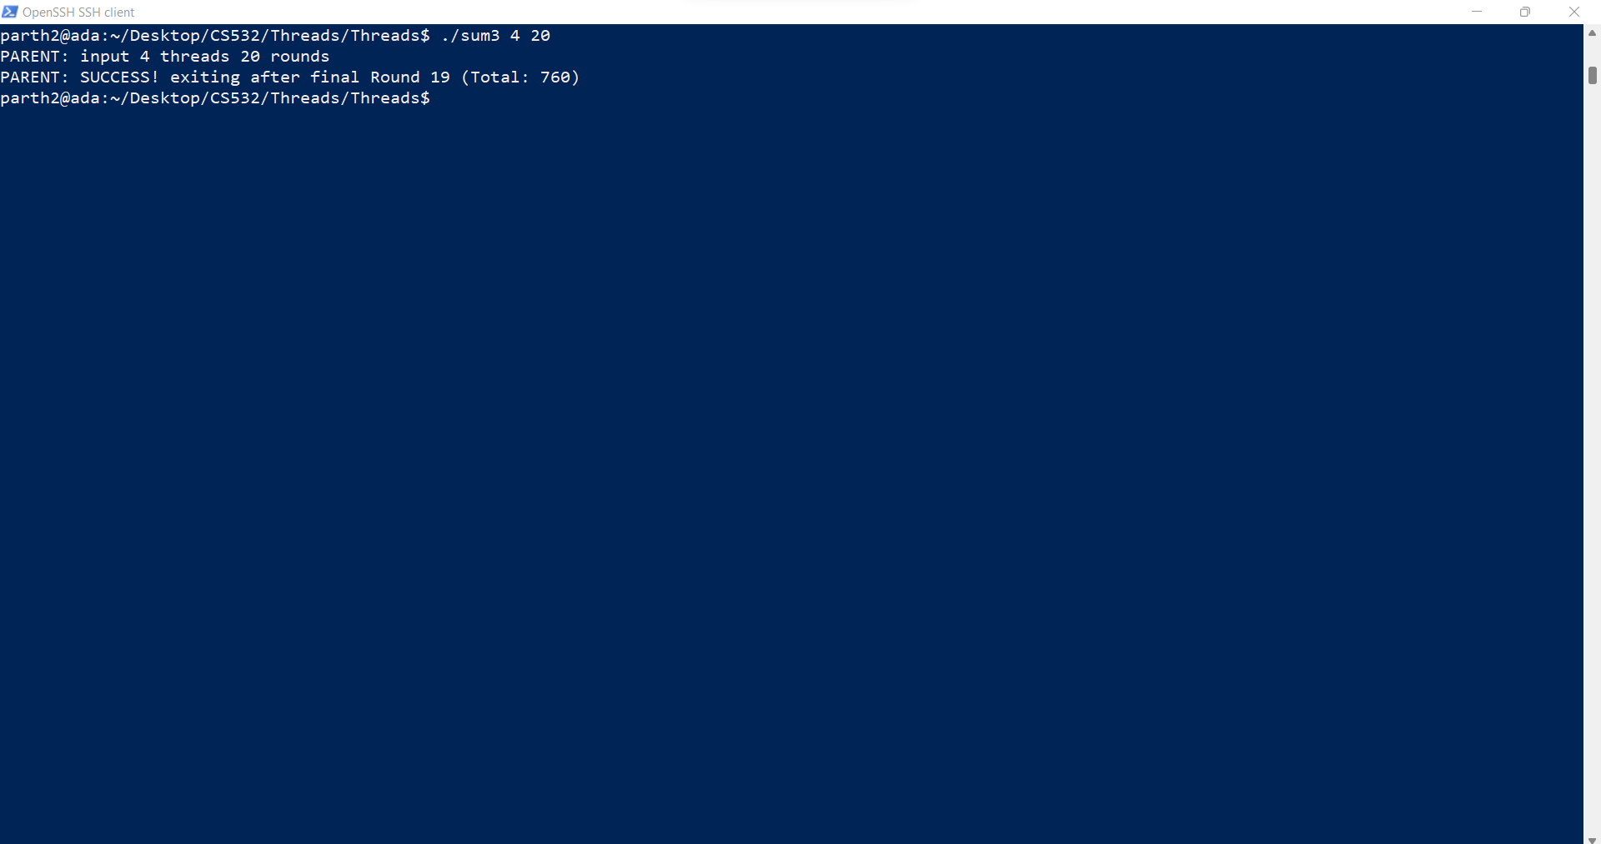
4 Threads and 20 rounds

Slide 22
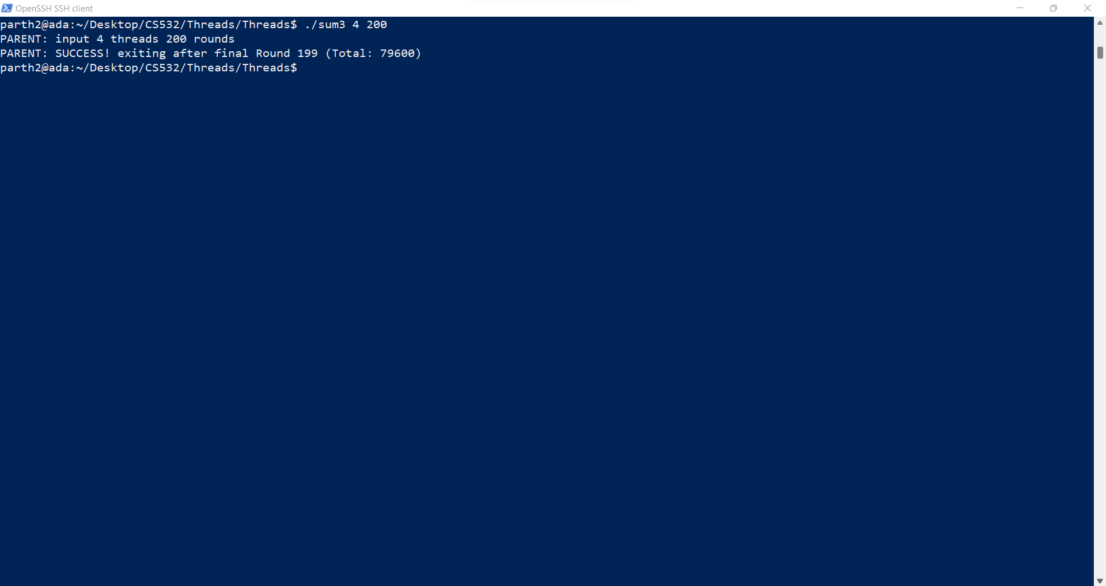
4 Threads and 200 rounds

Slide 23

4 Threads and 2000 rounds

Slide 24
4. Compare the performance of your sum2 vs. sum3 using 4 threads and 5 separate values of the "Rounds" input, ranging from 100 to MAXROUNDS. Construct a chart comparing the runtime of sum2 vs. sum3 for each Rounds input value. Show your chart on the next page.
(btw, one easy way to measure the runtime of a program on Linux is to run it with the time command like this: time <my command> )

Slide 25
Answer: - We have used the “time ./sum(x).c arg1 arg2” to benchmark the program and its multi-thread capabilities.
The time command gives us three values in the output namely: -
the elapsed real time between invocation and termination
the user CPU time (the sum of the tms_utime and tms_cutime values in a struct tms as returned by times(2))
the system CPU time (the sum of the tms_stime and tms_cstime values in a struct tms as returned by times(2))
Basically though, the user time is how long your program was running on the CPU, and the sys time was how long your program was waiting for the operating system to perform tasks for it. If you're interested in benchmarking, user + sys is a good time to use. real can be affected by other running processes, and is more inconsistent.
Hence, for benchmarking purposes, and for making the table and chart, I will be using the statistic (user + sys) timing for getting a proper tabular representation as well as the chart.
This figure will also help us benchmark the processes properly.

Slide 26
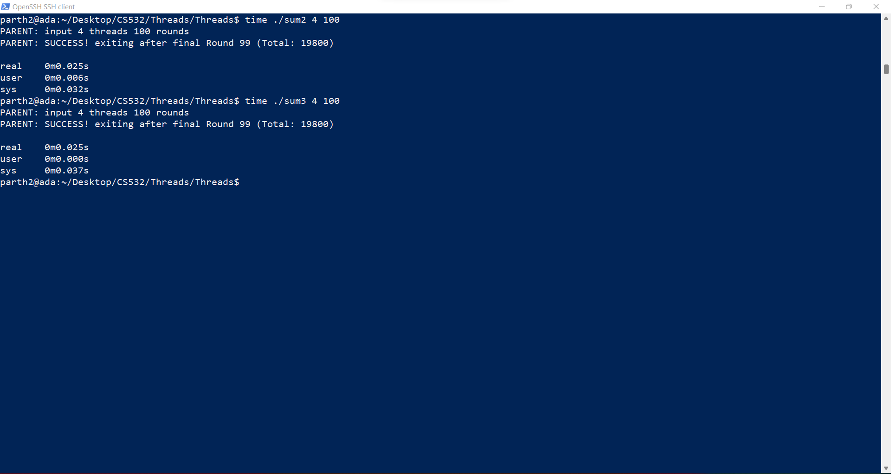

Slide 27


Slide 28
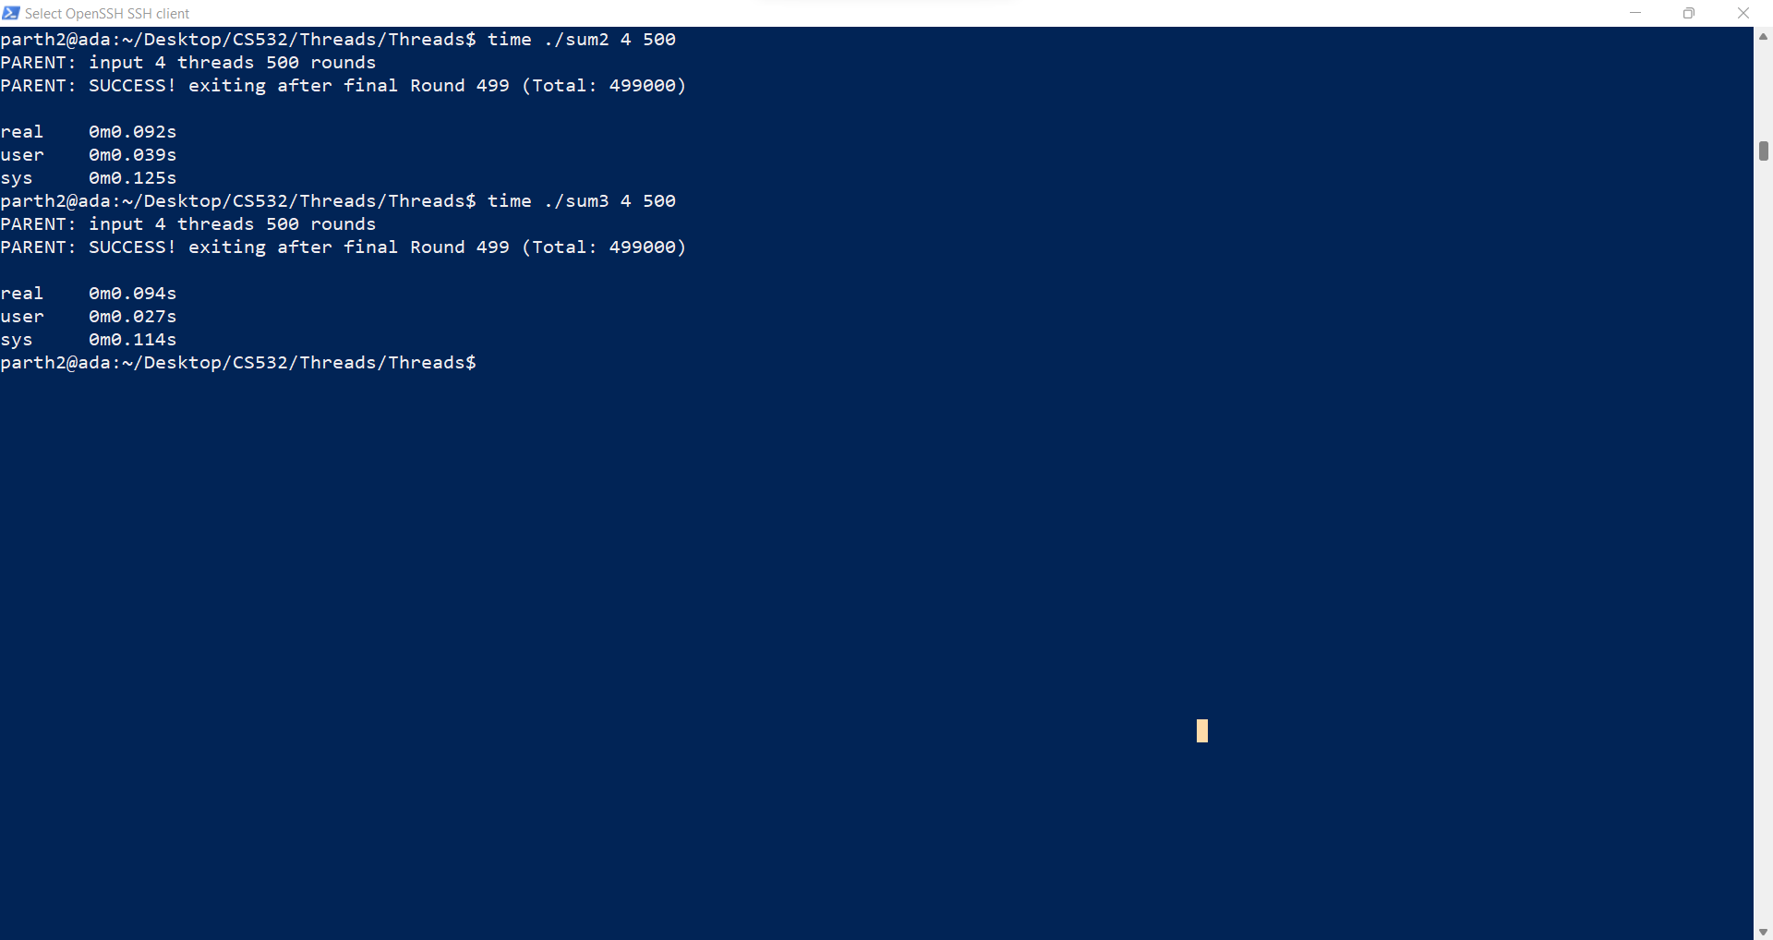

Slide 29
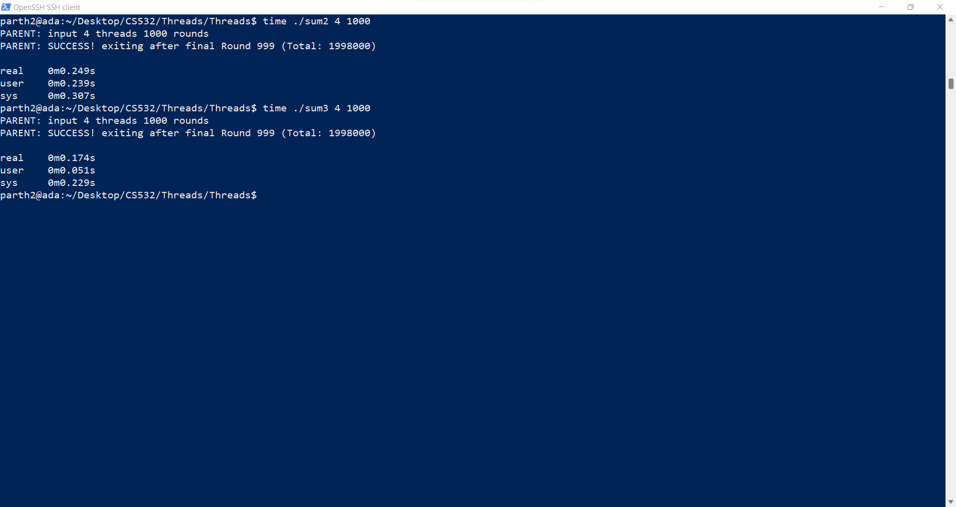

Slide 30
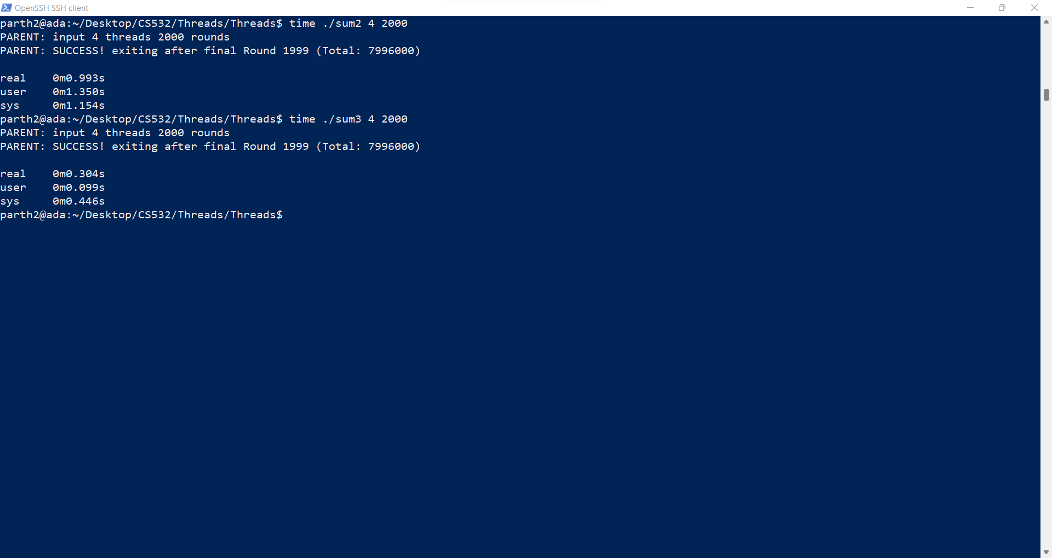

Slide 31
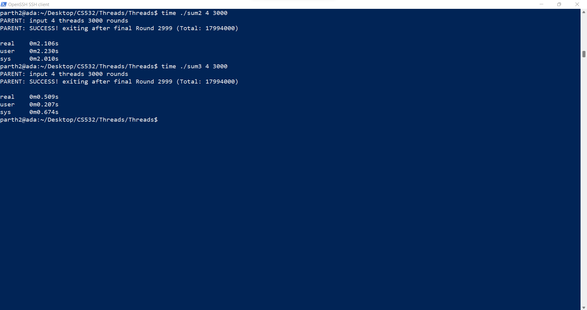

Slide 32


Slide 33
Runtime Comparison of sum2 vs. sum3
Rounds -> | 100 | 200 | 500 | 1000 | 2000 | 3000 | 5000
Time Taken by Sum2 | 0.038 | 0.079 | 0.166 | 0.546 | 2.504 | 4.240 | 13.449
Time Taken by Sum3 | 0.037 | 0.041 | 0.141 | 0.289 | 0.545 | 0.881 | 1.597
The time is given in the seconds. The number of threads used was constant at 4.
The time given is the sum of user and sys time obtained by using the time command in the previous slides.

Slide 34
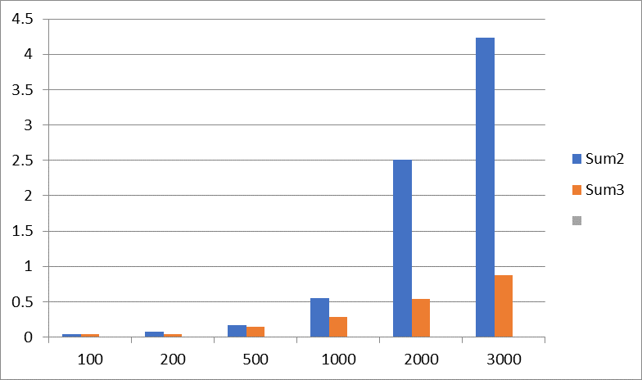
Time
in sec
Number of rounds ---->

Slide 35
5. What conclusions/observations do you make about the two fixed versions, sum2 and sum3?
As we can see from the graph as well as table from the previous slides, it can be concluded that sum3 performs better than sum2.
This performance gap is not visible if the number of rounds is less but as the number of rounds increase, it can be clearly seen that the performance gap increases and sum3 starts performing much better than sum2.
This can be attributed to the fact that the local variable of each thread is used and the sum is calculated by the localTotal variable for each thread. This creates a non-blocking scenario as we don’t need to synchronise the localTotal as it is local to each thread. These totals are then added to the Total variable which is a blocking variable. But these are added once each thread has calculated its sum of all the rounds. Thus, Total is called only after everything is done and thus the blocking is very less.
The same cannot be said about sum2 as there, we are updating the blocking variable Total everytime we are calculating the sum of the previous and current iteration. This creates a lot of blocking calls which hampers the performance of the Threads.
Well said

